Slide 1
Developing an Information Management Code Repository
Kristin Vanderbilt
Colin Smith
Environmental Data Initiative

Slide 2
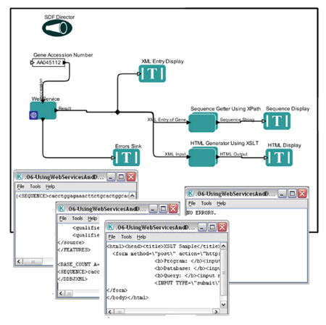
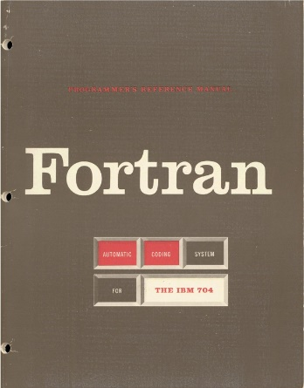



What is the IM code repository?
A community space where participants contribute code and discover code to re-use
For Information Managers, scientists, students, others
Limited to code for IM tasks
Language agnostic

Slide 3

Our goal today…
…is to create a blueprint for how the IM code repository will operate

Slide 4

Considerations:
Repository
Structure
Governance
Code
Reusability
Discoverability

Slide 5
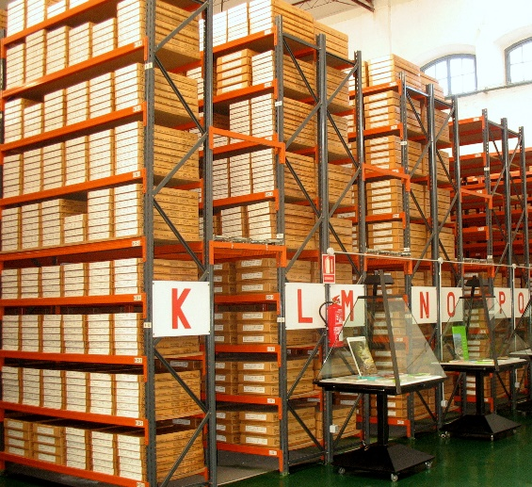
How should the IM Code Repository be structured?
Decentralized approach – the repository is essentially a catalog, pointing to whatever repository the code developer prefers
Centralized approach – all code is in github
Hybrid approach – a catalog plus the centralized github repository

Slide 6
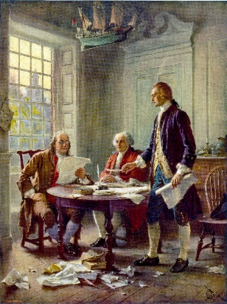
How should the code repository be governed?
A committee:
Specialists in different programming languages.
Responsible for ensuring that code passes quality tests and for evaluating metadata for quality and completeness.
Distributed workload.
Issues:
Number of members
Term of service
Credit for service

Slide 7

What are the minimum requirements for a script to be considered reusable?
Generalized, not project specific
Well documented at the code package level
CodeMeta minimal metadata schema for science software and code
Documentation of how code is installed and used
Well documented within the script
Code is thoroughly commented and adheres to a language-specific style guide
Passes tests of the code itself
Example inputs and expected output (use cases)
Code does what it says it says it will do
Robust to variations in inputs

Slide 8

What mechanisms will be employed to ensure that code is discoverable?
Develop a controlled vocabulary for CodeMeta (keywords element) and repository tags
Develop an application to query the software metadata
Author
Operating system specifics

Slide 9


Other considerations
Incentives to contribute to repository
Maintenance/updates of code
User support by code creator?
Licensing
Citation/DOI

Slide 10

Join us to finish the IM Repository blueprint!
Volunteers sought to co-author or review the ‘blueprint’

